Slide 1
Universal Response Engine: LLMs for Good
Team #35
Client: Ahmed Nazar
Advisor: Mohamed Selim

Slide 2
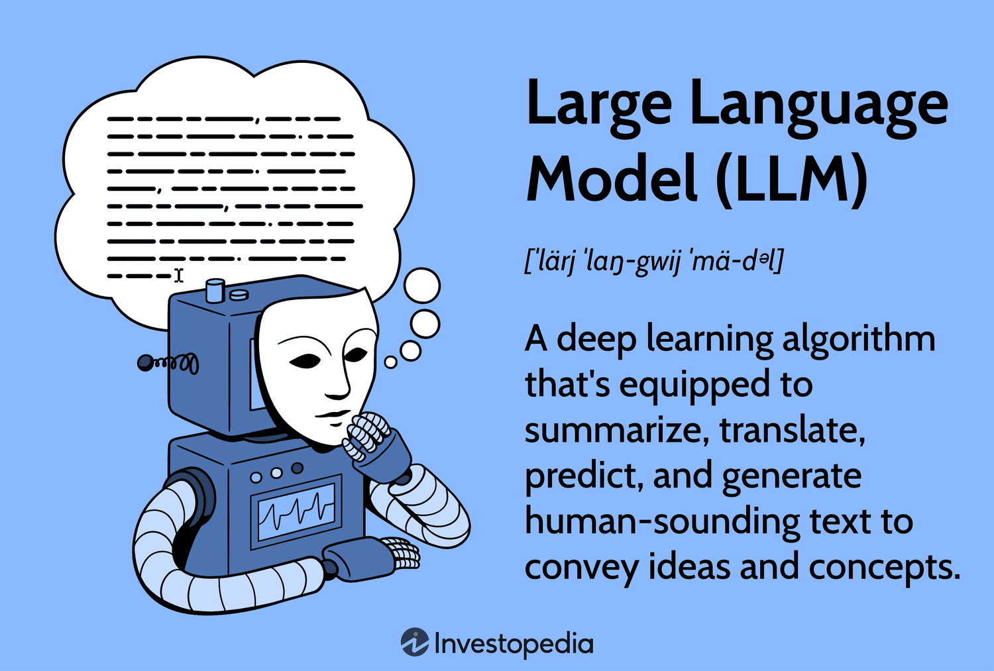
Notes:
What is an LLM?
Go back a few steps…
AI: broad term, intelligent machines
ML: subfield of AI, pattern recognition, predicting data
LLMs: subfield of ML, taking pattern recognition and a combination of other ideas to start generating text, like natural languages, and other data
How do LLMs work?
Combine lots of datasets
Feed data to a neural network that processes it with calculations (like calculating similarity between words)
Finetune it by training it on specific datasets

Slide 3
Project Overview
Creating an LLM for humanitarian use
Chatbot-like website where users provide questions/prompts
Model responds with relevant links, media, info (multimodal)
Notes:
Our project aims to address a critical gap in accessible and comprehensible support for individuals facing challenges. Many people experience difficult circumstances and may feel isolated when seeking help. Although there are a lot of good resources available, they are often fragmented and require these distraught people to sift through multiple pages of information from different sources.
What makes it different: societal good, open-source, no data tracking, to help people in vulnerable situations
Fine-tuned, trained, vetted on empathetic datasets that provide medical advice, emergency advice, etc.

Slide 4
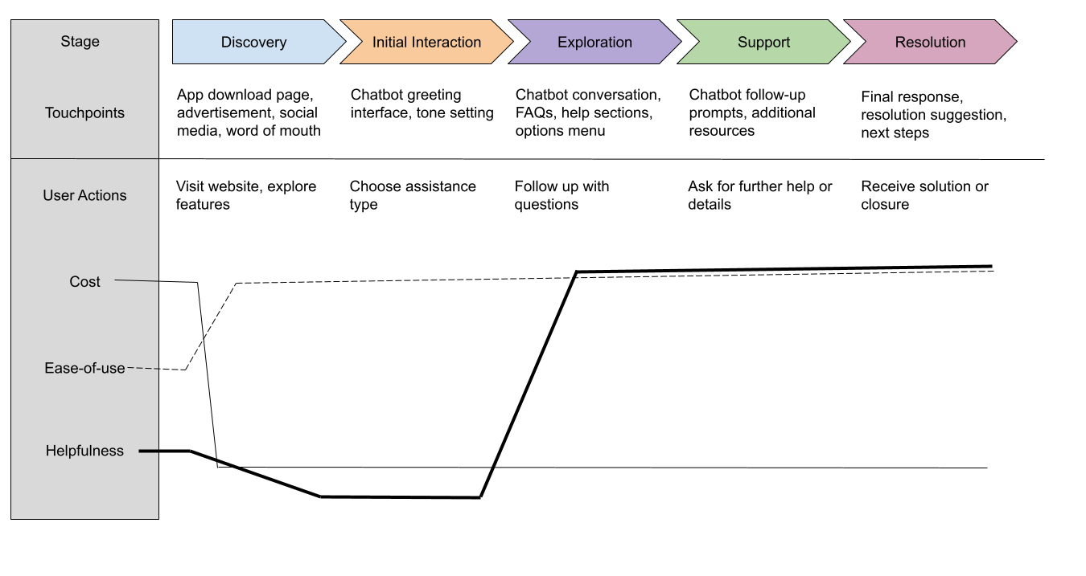
Journey Map

Slide 5
Pros / Cons Table
Feature | Pros | Cons
Multimodal user input | Supports diverse user needs (text, voice, etc.) | Increase the technical complexity
Sentiment analysis | Improves empathy and urgent cases | May misinterpret emotions or nuance
Security | Protects sensitive health data | High Cost & complexity for protection
Accessibility | Helps assist users with disabilities (example: voice support) | Requires more development for compatibility

Slide 6
Technical Complexity Analysis
High complexity
Tone adjustment based on sentiment analysis
Implementation of retrieval augmented generation and fine tuning of LLM
Collection and creation of high quality datasets
Medium complexity
Making the user interface appealing and accessible
Chat session data security
Low complexity
Constructing the user interface

Slide 7
Design Solution - Human
User needs: accessible, secure, empathetic, trustworthy information about medical or mental health topics
Our product will address and satisfy all of these needs
Improvements: making the product also available as a mobile application and including sentiment analysis to change the tone of the response

Slide 8
Design Solution - Technical
Improvements upon existing solutions
Multimodal input from user - text and images
Accessibility - user does not have to create an account
Security - model will not store chat sessions with users
Drawbacks
Possible misinterpretation of model’s response
Mitigation - focus more on pointing the user to credible resources than having drawn out answers to queries
Accuracy of sentiment analysis and possible bias in model responses
Mitigation - training the model on personalized data that is of high quality

Slide 9
Design Solution - Economic
Internal Complexity
Being able to accept multimodal input from the user
Justification: added complexity to having the model decode and use a possible image from the user along with text
Tailor response tone with sentiment analysis
Justification: will require more training data and has not been done before
External Complexity
Friendly user interface
Justification: must analyze topics such as accessibility, contrast, and navigability
These complexities showcase our in-depth understanding of LLMs, engineering ethics, and user-centered design.

